Slide 1
Value-Chain Analysis
Value-chain analysis
  a strategic analysis of an organization that uses value creating activities.
Value is the amount that buyers are willing to pay for what a firm provides them and is measured by total revenue

Slide 2
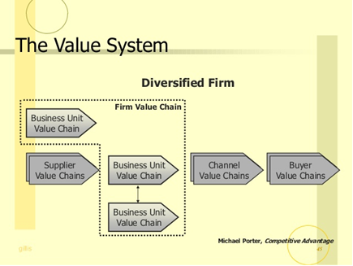
The Value Chain System

Slide 3
Value-Chain Analysis
Primary activities
  contribute to the physical creation of the product or service, its sale and transfer to the buyer, and its service after the sale.
  inbound logistics, operations, outbound logistics, marketing and sales, and service

Slide 4
Value-Chain Analysis
Support activities
  activities of the value chain that either add value by themselves or add value through important relationships with both primary activities and other support activities
  procurement, technology development, human resource management, and general administration.

Slide 5
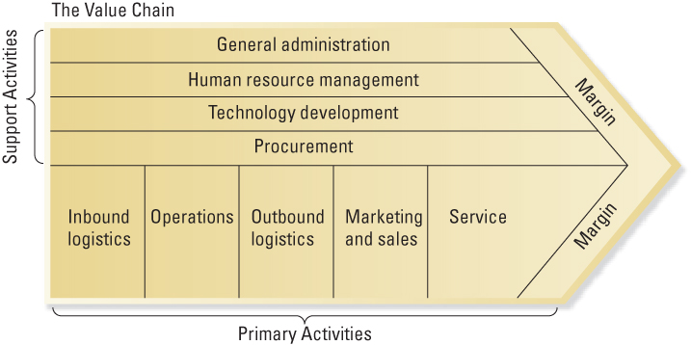
Porter’s Value Chain Model

Slide 6
Interrelationships among Value-Chain Activities
Two levels
Interrelationships among activities within the firm
Relationships among activities within the firm and with other organization (e.g., customers and suppliers)

Slide 7
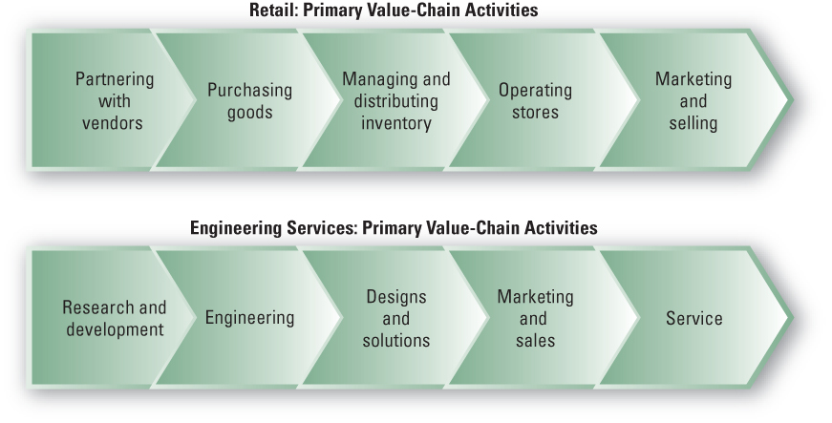
Value Chains in Service Industries

